Slide 1
Screening Chest X-rays for Covid-19 with Deep Learning
Eric Robert Gill – June 2021
Tutor: Joan M. Nuñez Do Rio
Professor: Joan Arnedo Moreno

Slide 2
Contents
Context and Justification
Objectives
Medical Context
Technology
Data
Experiments
Results
Discussion
Conclusions

Slide 3
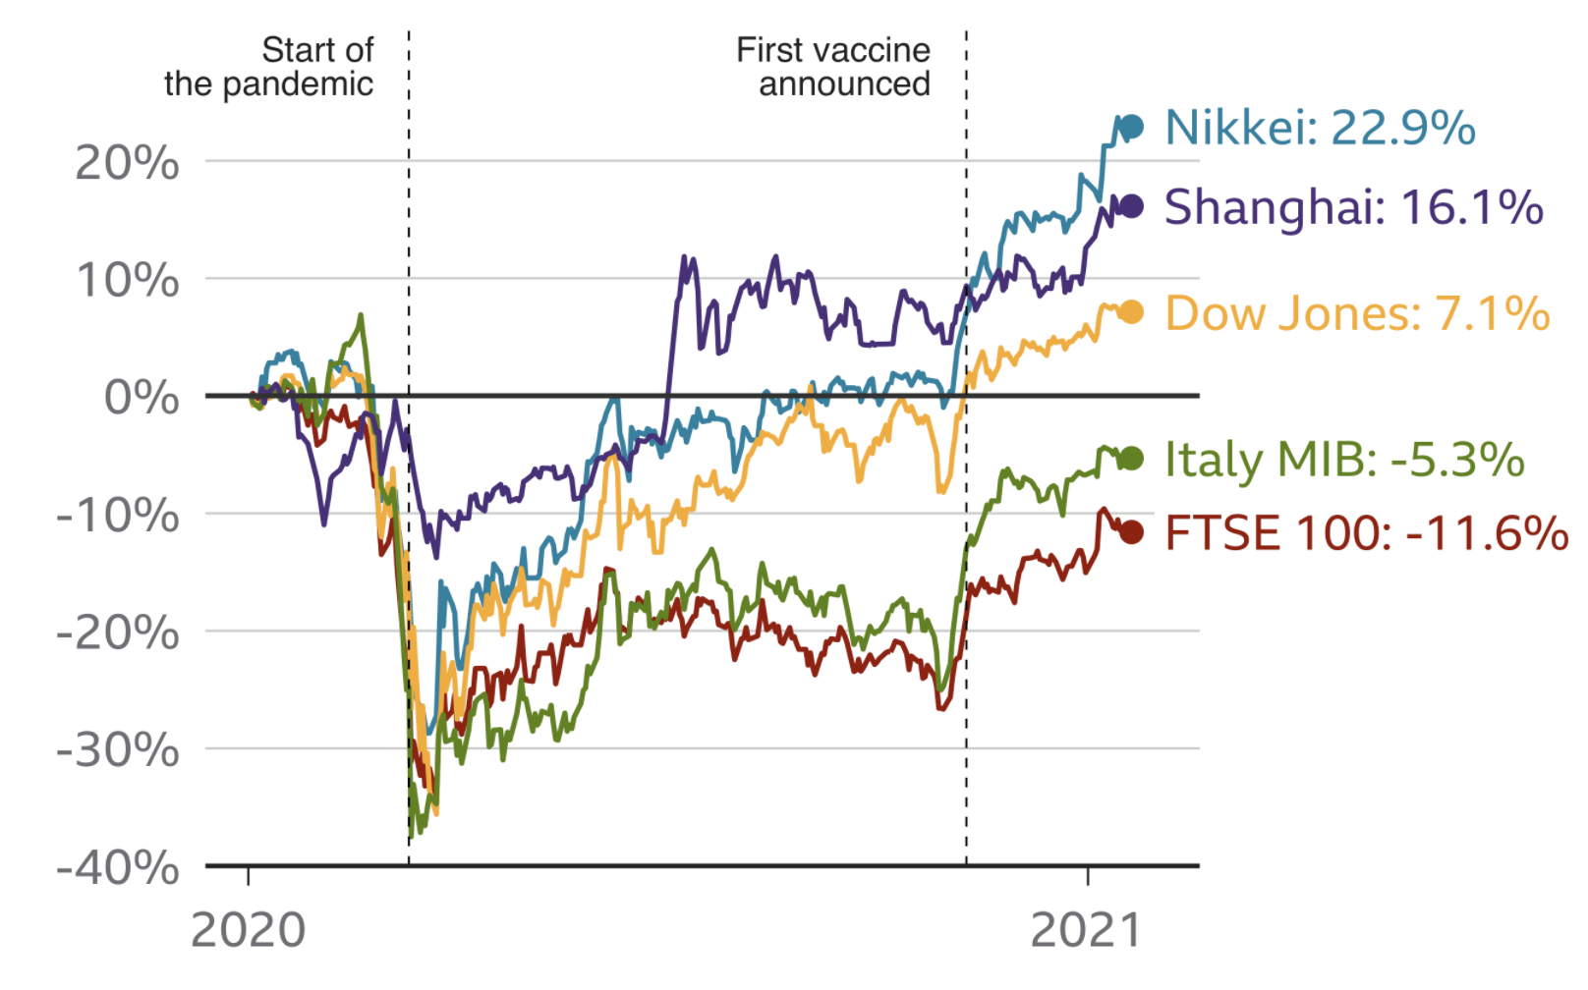
Context – The Coronavirus
3,467,722 deaths since 31st December 2019¹.
Predicted economic losses of up to $8.8 trillion worldwide².
Market instability despite vaccination announcements.
Image courtesy of BBC.com
European Centre for Disease Control, 2021
Baig et al., “Deaths, panic, lockdowns and US equity markets: The case of COVID-19 pandemic,” Finance Research Letters, 2021

Slide 4
Context - Prevention
Strategies generally involve detection and isolation.
Testing with PCR and antigens tests.
Can be expensive¹, require resources.
Deep learning and X-rays show potential to help^{2, 3, 4}.
Neilan et al. “Clinical Impact, Costs, and Cost-effectiveness of Expanded Severe Acute Respiratory Syndrome Coronavirus 2 Testing in Massachusetts,” Clinical Infectious Diseases 2020
M. E. H. Chowdhury et al., “Can AI Help in Screening Viral and COVID-19 Pneumonia?,” IEEE Access 2020
S. Minaee et al., “Deep-COVID: Predicting COVID-19 from chest X-ray images using deep transfer learning,” Medical Image Analysis 2020
P. Kedia et al., “CoVNet-19: A Deep Learning model for the detection and analysis of COVID-19 patients,” Applied Soft Computing 2020

Slide 5
Objectives
Use deep learning to classify images of lungs into one of three classes: Covid-19, Normal or Viral Pneumonia.
Investigate Convolutional Neural Networks and techniques to increase performance and compare results with baseline results found in literature.
Investigate feasibility of applying deep learning to this kind of medical screening.
Compare results obtained with results from a pretrained model using transfer-learning to fine-tune its parameters.

Slide 6
Medical Context
Medical imaging heavily used in diagnosis.
Chest x-rays (CXR) considerably cheaper than alternatives¹.
Pneumonia detected in CXR with deep learning (DL)^{2, 3}.
Several papers succeed in detecting Covid-19 in CXR with DL^{4, 5, 6}.
Wielputz et.al., ﻿﻿Deutsches Arzteblatt International, 2014.
N. M. Elshennawy et.al. Deep-Pneumonia Framework Using Deep Learning Models Based on Chest X-Ray Images,” Diagnostics 2020
T. Rahman et al., “Transfer learning with deep Convolutional Neural Network (CNN) for pneumonia detection using chest X-ray,” Applied Sciences (Switzerland), 2020
M. E. H. Chowdhury et al., “Can AI Help in Screening Viral and COVID-19 Pneumonia?,” IEEE Access 2020
S. Minaee et al., “Deep-COVID: Predicting COVID-19 from chest X-ray images using deep transfer learning,” Medical Image Analysis 2020
P. Kedia et al., “CoVNet-19: A Deep Learning model for the detection and analysis of COVID-19 patients,” Applied Soft Computing 2020

Slide 7
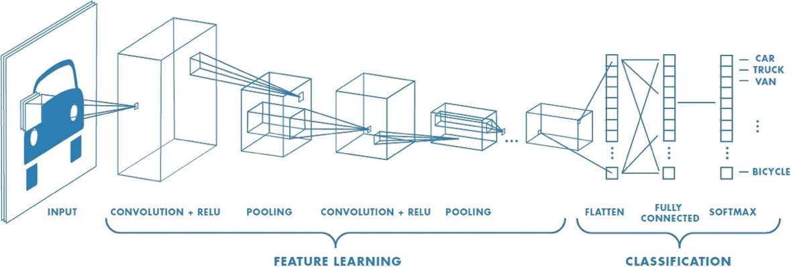
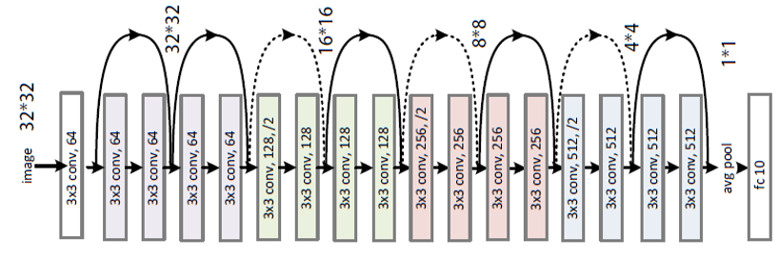
Techniques employed
Convolutional Neural Network (CNN).
Data Augmentation.
Batch Normalization.
L2 Regularization.
Dropout.
Transfer learning.
CNN Vo. 2018
ResNet18, programmersought.com

Slide 8
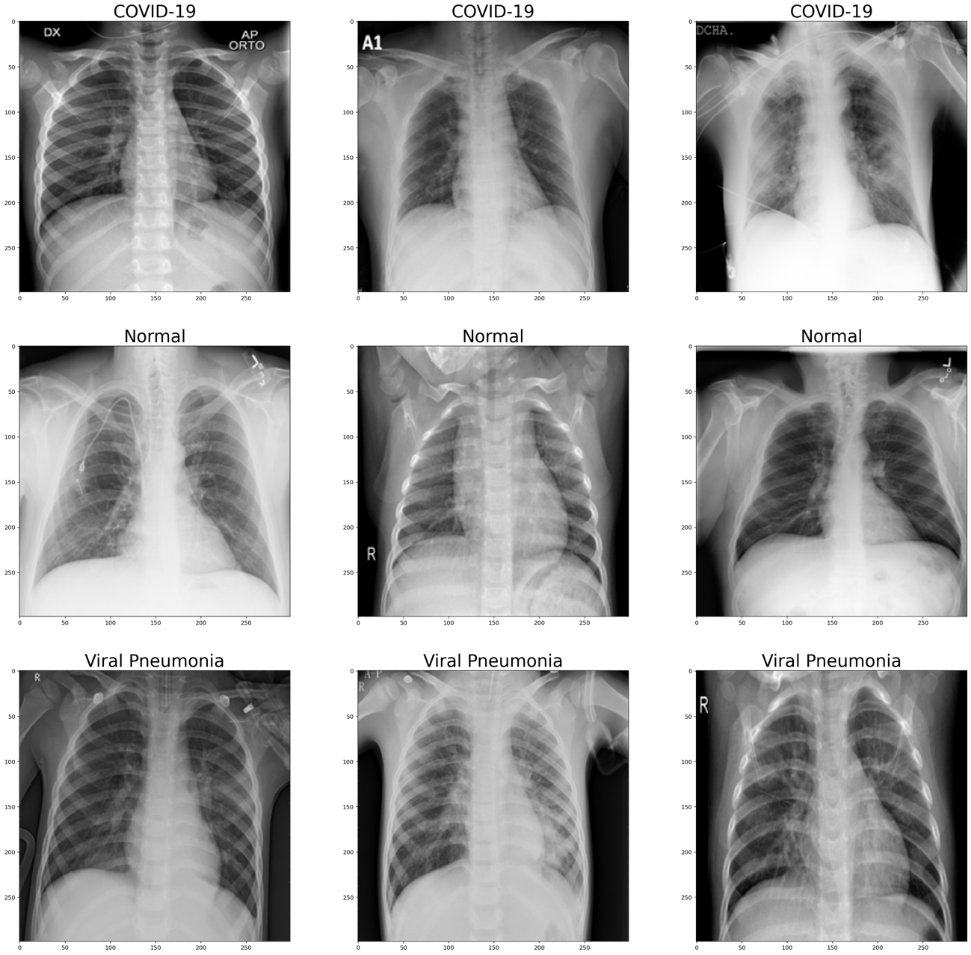
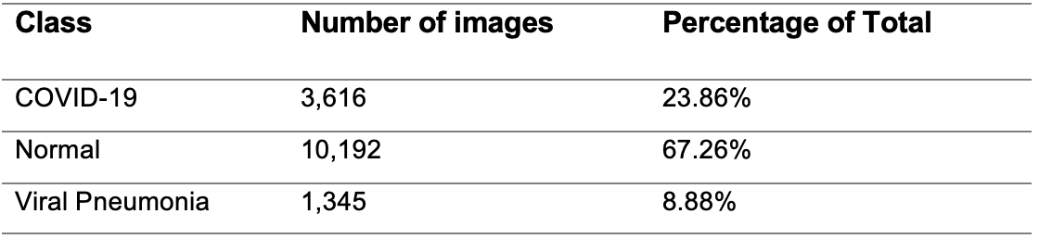
Data

Slide 9
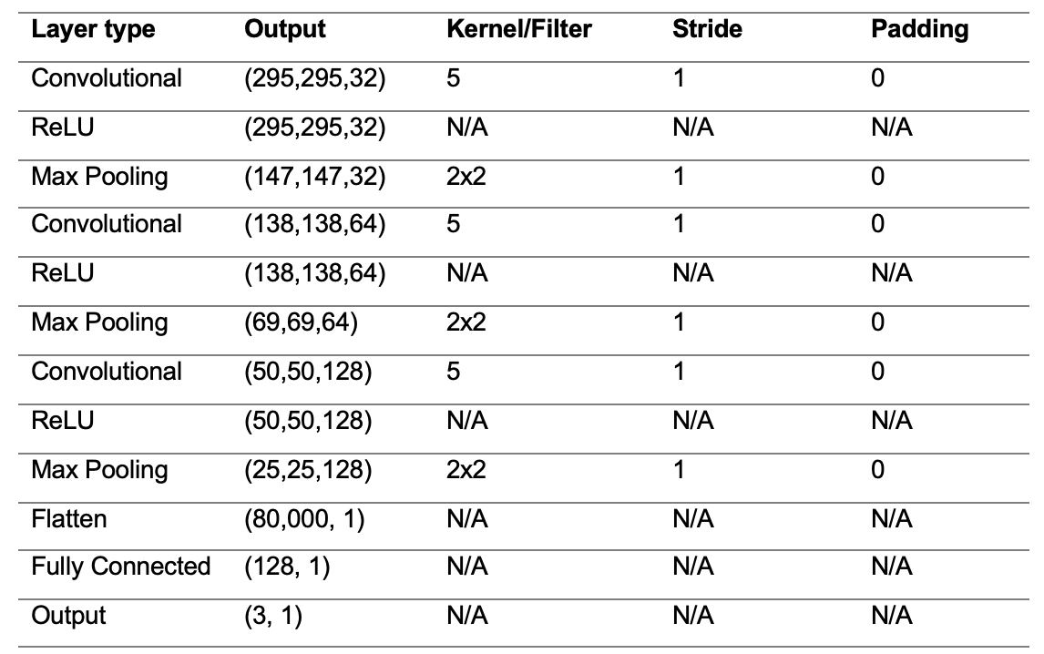
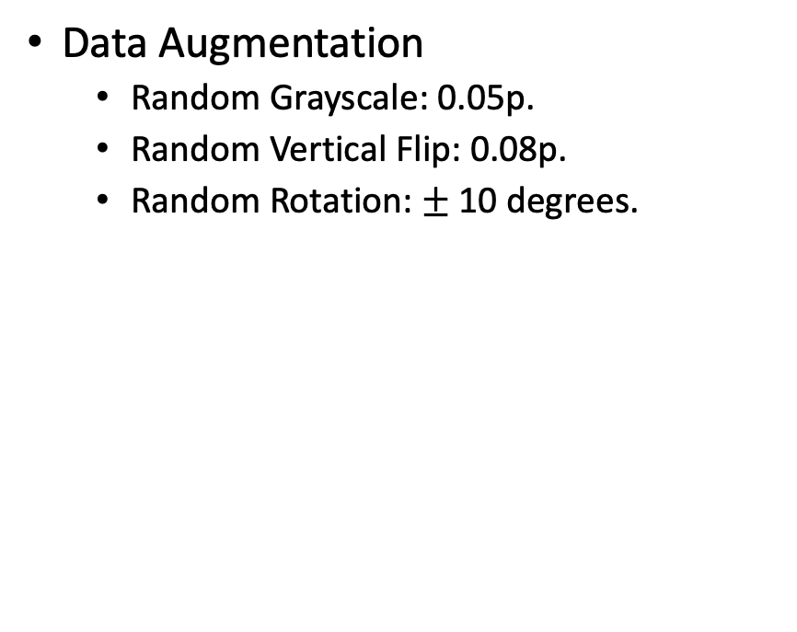
Experiments - 1
Experiment 1
Experiment 2
Data Augmentation
Random Grayscale: 0.05p.
Random Vertical Flip: 0.08p.
Random Rotation: $±$ 10 degrees.

Slide 10
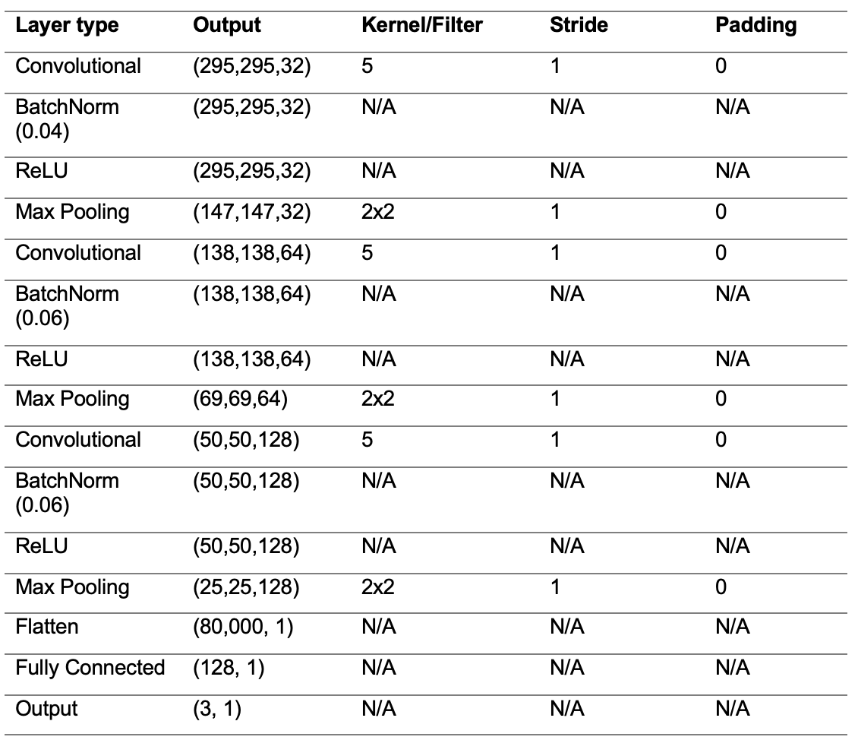
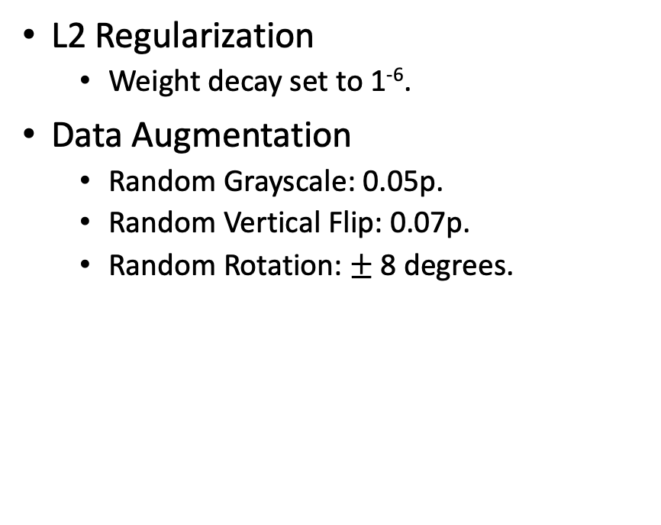
Experiments - 2
Experiment 3
Experiment 4
L2 Regularization
Weight decay set to 1⁻⁶.
Data Augmentation
Random Grayscale: 0.05p.
Random Vertical Flip: 0.07p.
Random Rotation: $±$ 8 degrees.

Slide 11
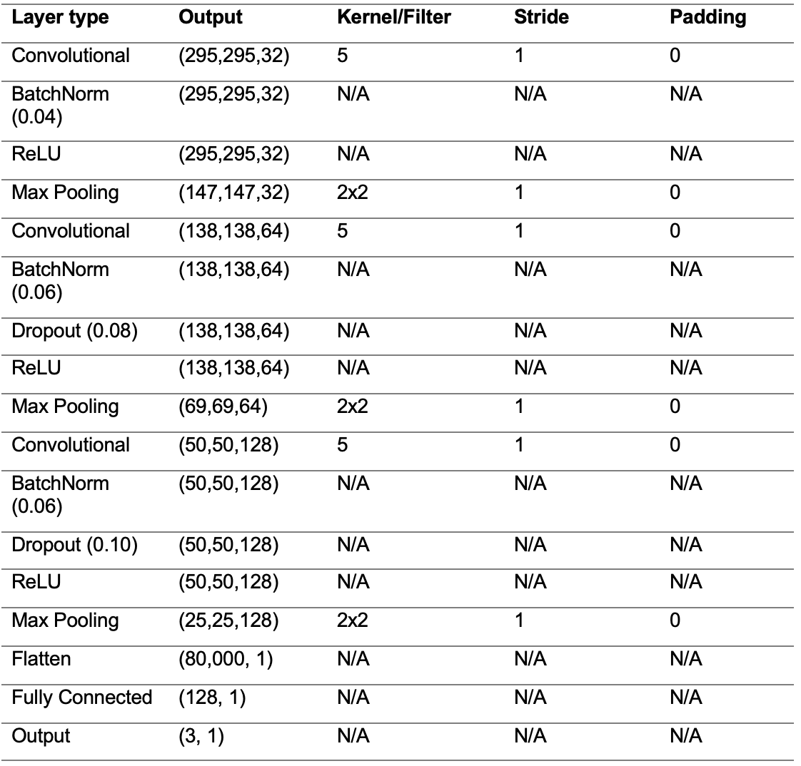
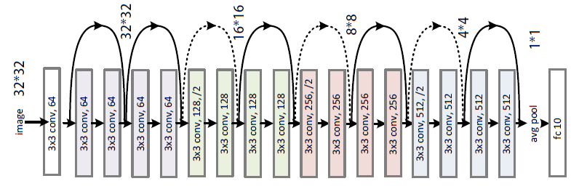
Experiments - 3
Experiment 5
Experiment 6
ResNet18
Courtesy of programmersought.com

Slide 12
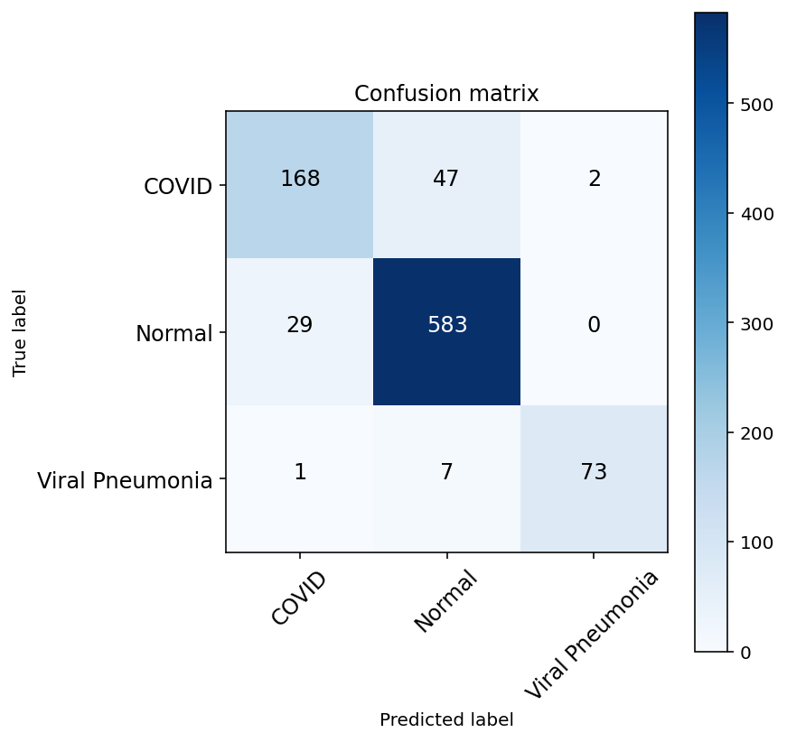
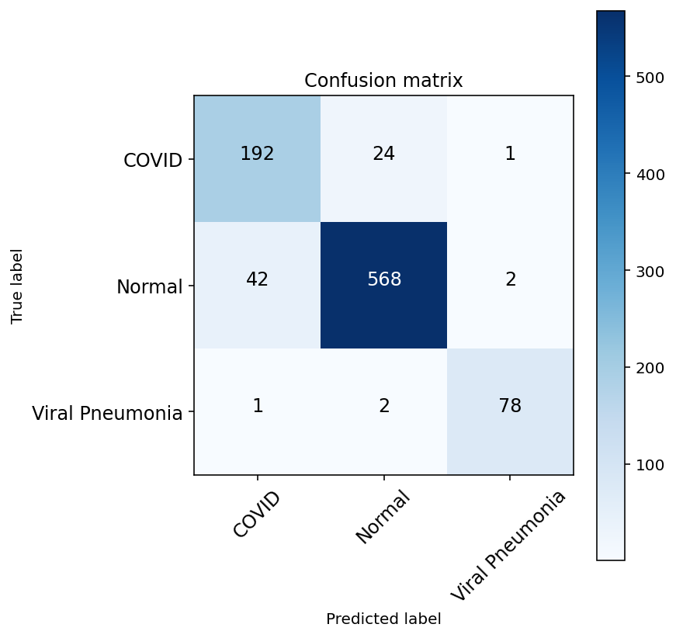
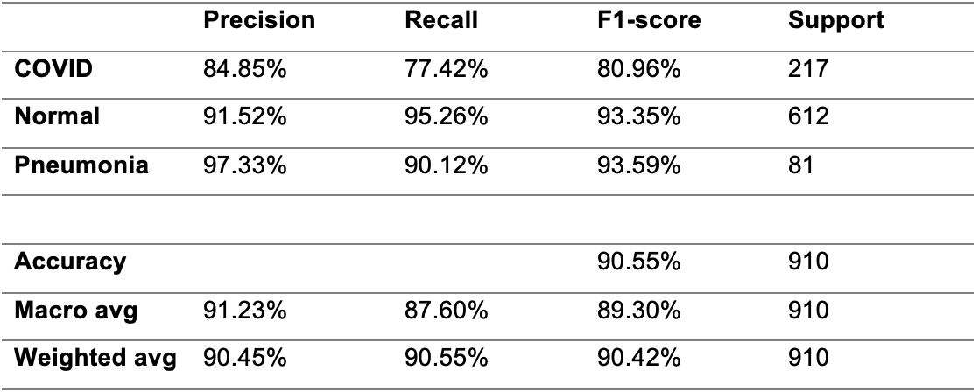
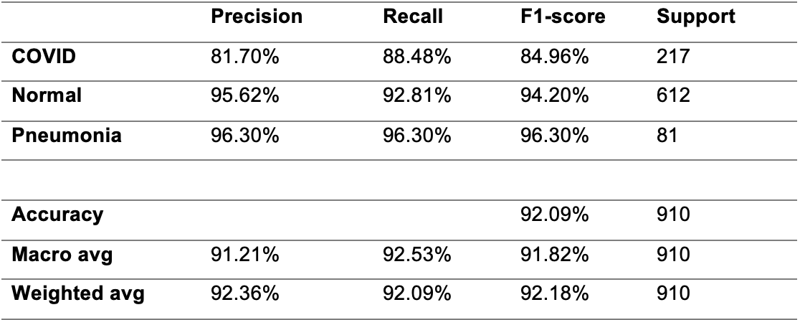
Results - 1
Experiment 1
Experiment 2

Slide 13


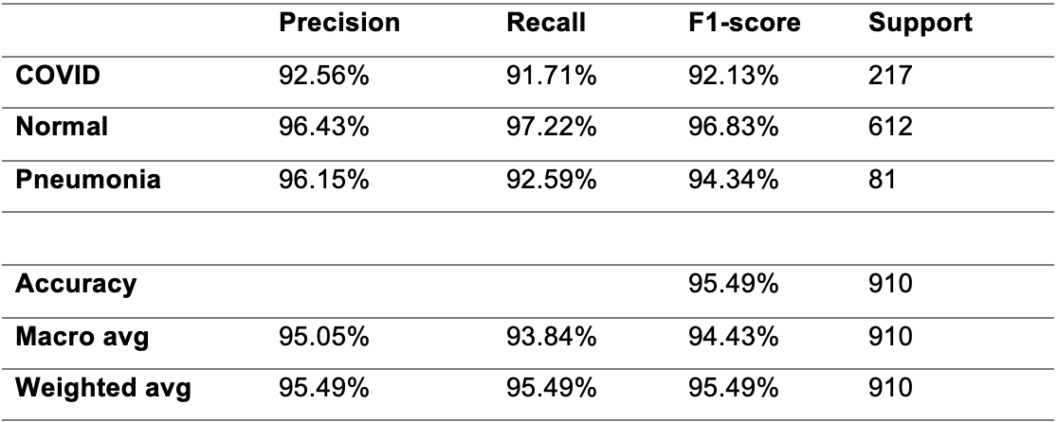
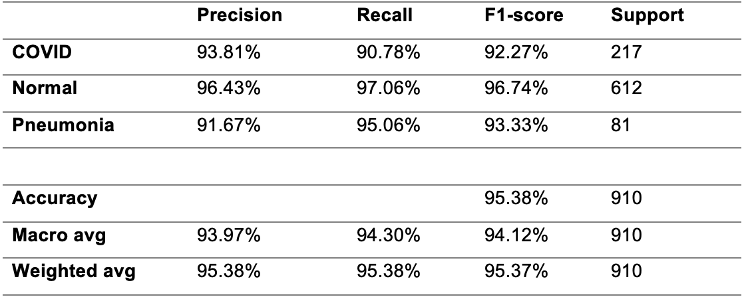
Results - 2
Experiment 3
Experiment 4

Slide 14

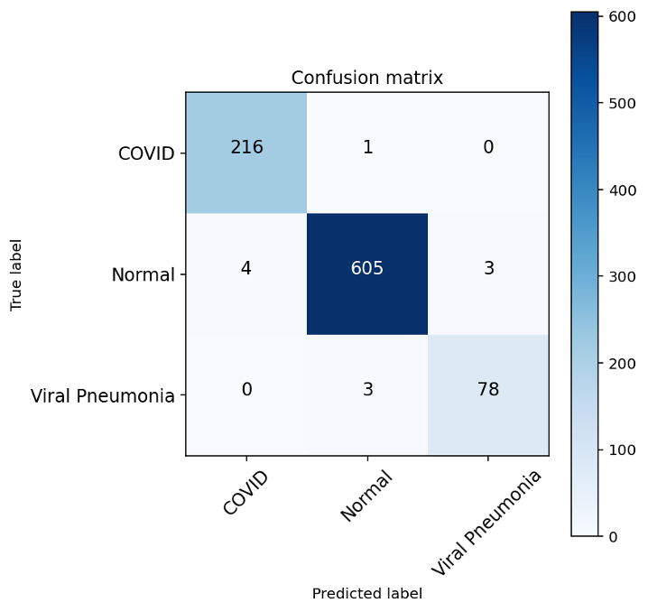
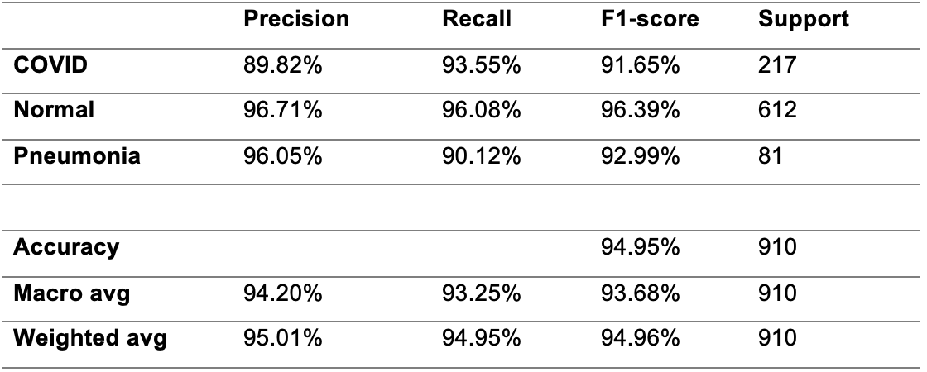
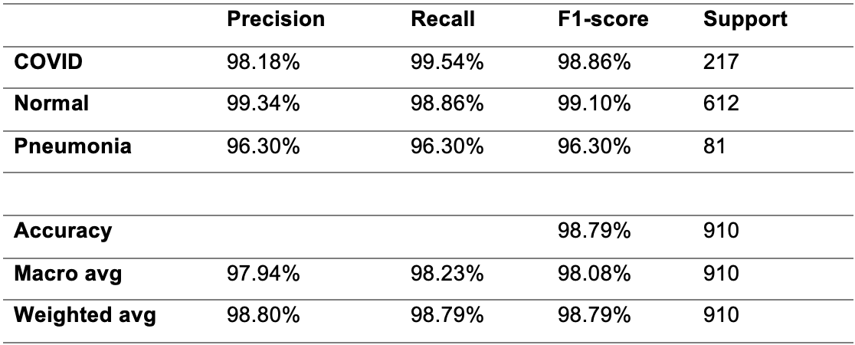
Results - 3
Experiment 5
Experiment 6

Slide 15
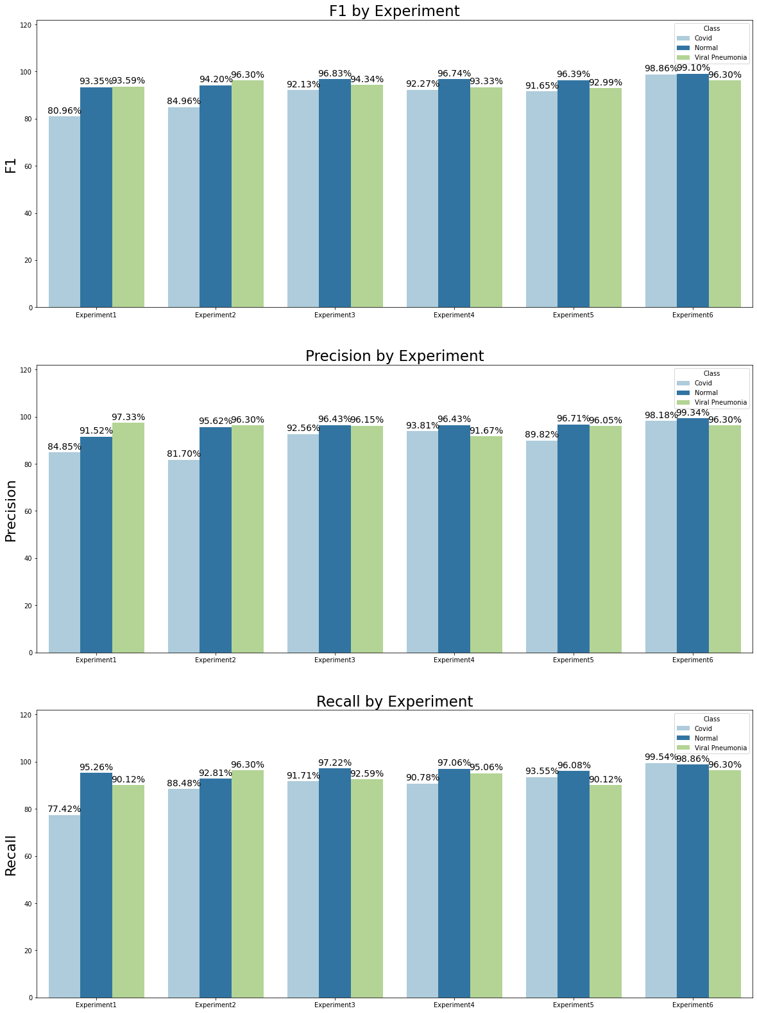
Discussion
Data augmentation improved recall on Covid class^{1, 2}.
Batch Normalization improved three metrics on Covid class.
L2 regularization produced higher precisions in Normal and Covid classes than preceding experiments.
Dropout produced highest recall in Covid.
Transfer Learning shows high potential¹.
S. Minaee et al., “Deep-COVID: Predicting COVID-19 from chest X-ray images using deep transfer learning,” Medical Image Analysis 2020
P. Kedia et al., “CoVNet-19: A Deep Learning model for the detection and analysis of COVID-19 patients,” Applied Soft Computing 2020

Slide 16
Conclusions
Compelling results suport hypothesis.
High recall achieved for Covid and Viral Pneumonia.
X-rays cheap, massively available.
Further studies with more data are feasible.
Transfer learning appears key.

Slide 17
Thank you for your time

